Slide 1
Wel-Come

Slide 2
What is flow chart ?
DATE : 11/10/22
Flowchart is a diagrammatic representation of sequence of logical steps of a program.
It helps to understand the algorithm into program.
And in flowchart there are some geometric shapes who helps to represent the process / data flow.

Slide 3
Advantages of flow chart ?
Flowcharts are a better way of communicating the logic of the system.
Flowcharts act as a guide for blueprint during program designed.
With the help of geometric shape we can analysed the program easily.
It is easy way to represent the process / data flow in the program.
It provide the correct logic.

Slide 4
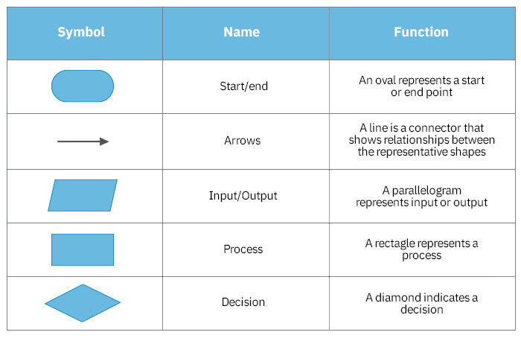
What are the various symbols used to draw a flow chart ?
There are so many symbols to draw flow chart but some 5 symbols are given below.

Slide 5
Develop a flow chart for reading 3 nos and find their average ?
START
“Average of 3 integers”
“Input 3 integers”
Input a,b,c
Ave <- (a+b+c)/3
Output
“Average is ”, Ave
END

Slide 6
What is an algorithm ?
An algorithm is a procedure or step-by-step instruction for solving a problem. They form the foundation of writing a program. For writing any programs, the following has to be known:
Input.
Tasks to be preformed.

Slide 7
Advantages of an Algorithm ?
It is easy to understand.
An algorithm is a step-wise representation of a solution to a given problem.
In Algorithm the problem is broken down into smaller pieces or steps hence, it is easier for the programmer to convert it into an actual program.

Slide 8
Draw a flow chart , develop an algorithm to generate a marksheet of a student ?
ALGORITHM
Step 01 : START
Step 02 : Input = name , math , physics , chemistry , biology
Step 03 : Read : name , math , chemistry , physics , biology
Step 04 : Ave <- (math + chemistry + physics + biology )/4.00
Step 05 : Output “Average of student marks”, Ave
Step 06 : END

Slide 9
FLOW CHART
START
INPUT :- name , rno, math,physics, chemistry,biology
Read : name , rno , math , physics , chemistry , biology ,obtained mark
Ave<-(math+chemistry,biology,physics )/4
Output : “Average of student marks”
END

Slide 10
History of C language ?
Date :- 13.10.2022
What is c ?
C is a structured, procedural programming language.
that has been widely used both for operating systems and applications .
C programming language was developed in 1972 by Dennis Ritchie at bell laboratories of AT&T (American Telephone & Telegraph), located in the U.S.A.
It was developed to over come problem of prev. lang. As B, BCPL, etc.
It was developed to be used in UNIX operating system.

Slide 11
Why we use c ?
Body structure of C
C program is divided into six sections: Documentation, Link, Definition, Global Declaration, Main() Function, and Subprograms.
While the main section is compulsory, the rest are optional in the structure of the C program.
C is mainly used to create many types of applications and operating systems such as Windows.
It is use to complicated programs such as the Oracle database, Git, Python interpreter, and games

Slide 12
Advantages of C languages ?
C is medium level language.
C is structured programming language .
C language is case-sensitive.
C language is easy to write .

Slide 13
THANK YOU SIR

